Slide 1


Museum of Network Models
COMP 2100 03B
Anthony Ferrucci
Robert Yildirim
Raghav Vaid
November 17, 2024

Slide 2
MONM: roadmap
Intro/Background
How does it work?
Design/Implementation
Why VR?
Scope
Approaches that worked
Demo
Limited to Unity
Testing/Bugs
Break stuff!
Conclusion
Recommendations
Q&A

Slide 3
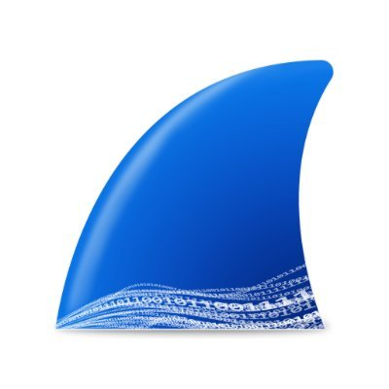
Problem
Networking is "invisible"
Relies on analogies
Concepts too abstract
Difficult for students to understand
ex. Wireshark capturing packets out of thin air
Notes:
Networking isn’t very intuitive for students, since there’s little grounding it to the physical world. We can’t see packets, data, etc without tools

Slide 4
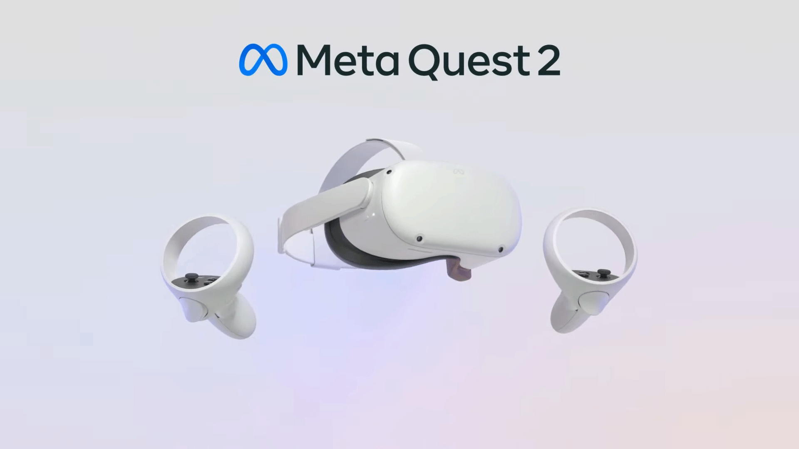
Objectives
Visualize networking
Bring analogies to life
Learn about VR
Used in more industries
Scope changed with problems we encountered
Notes:
We wanted to use VR’s interactive capabilities to give network theory a visual basis. We also wanted to learn how to build stuff in VR, which is still an emerging technology.

Slide 5
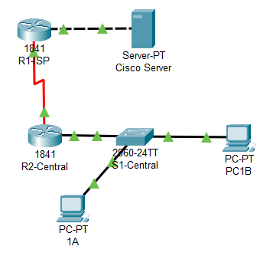
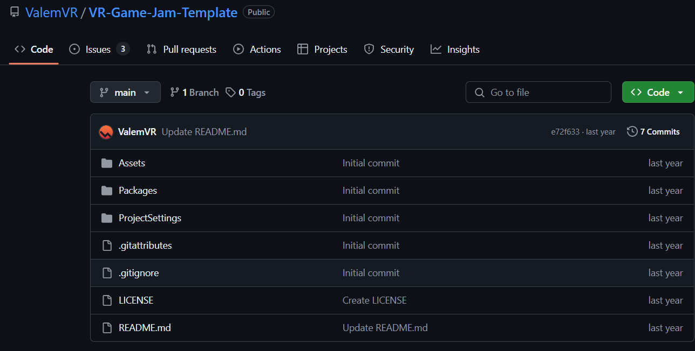
Background and Related Work
VR projects unrelated to networking
CISCO is 2D

Slide 6
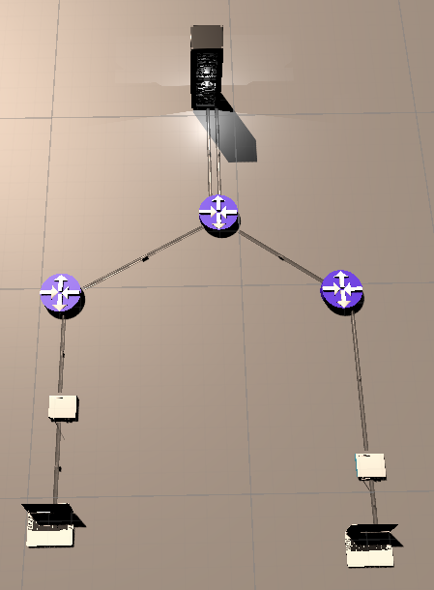
Architecture Used
Client-Server architecture
Low-throughput
Lag
Concise movement
Notes:
Laptop sends packets to server, server to other laptop. The packets move through the wires in the right direction too (details!)
The packets only fire one at a time from each node in the network. Fewer moving objects in Unity reduces the amount of lag we get, and it also makes it clearer to the user what is going on since they can see how the packets move. If it was realistic speeds, you wouldn’t be able to see anything valuable.

Slide 7
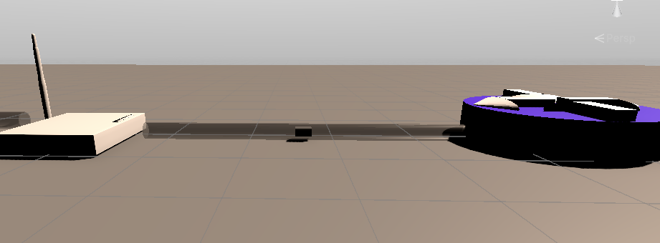
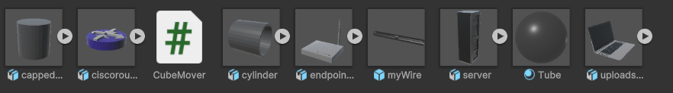
Key Features
Moving cubes = packets
Objects use prefabs
Build just like in CISCO

Slide 8
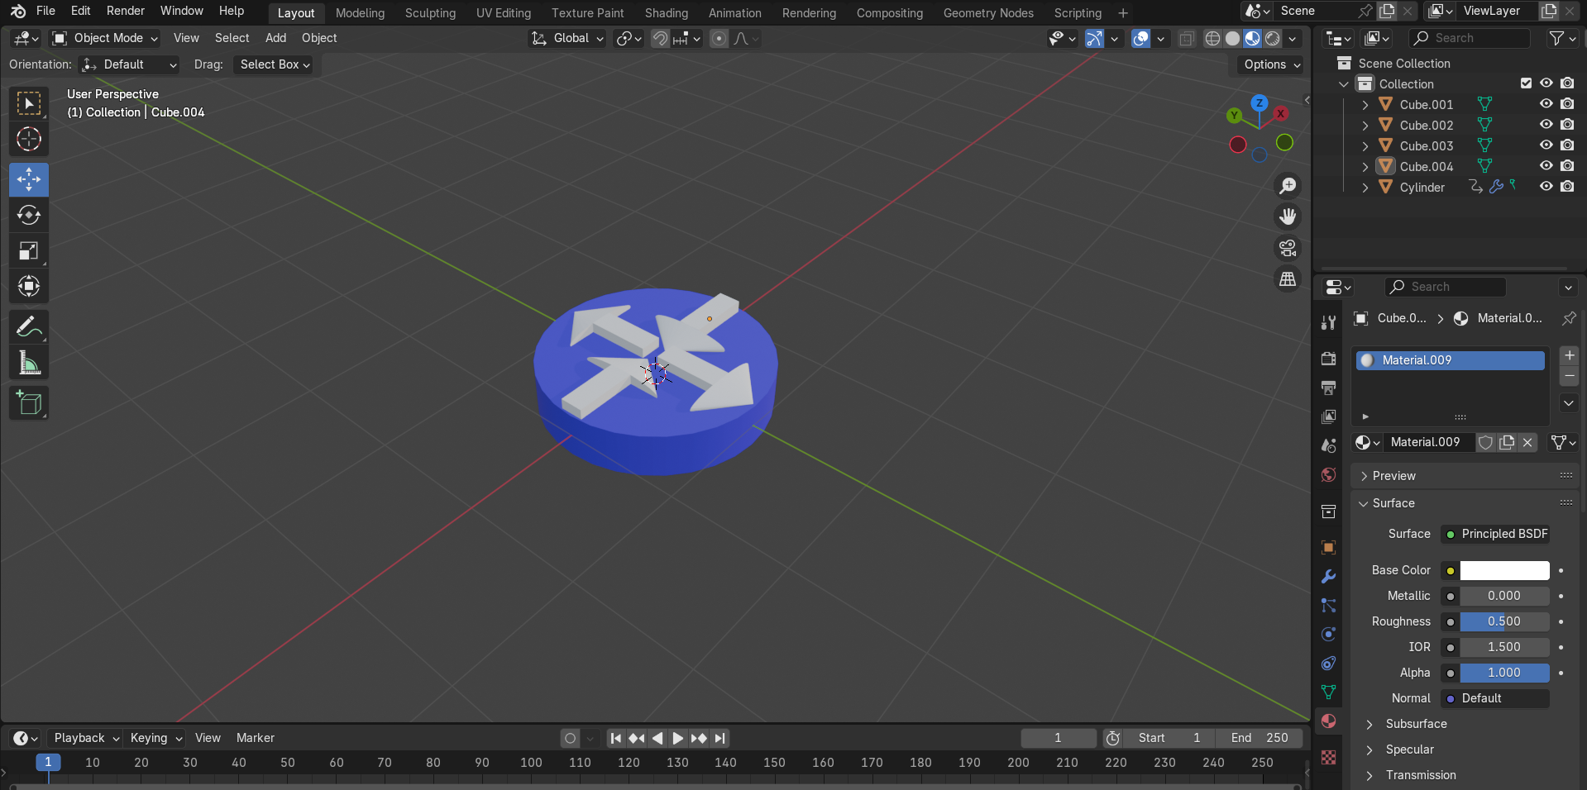
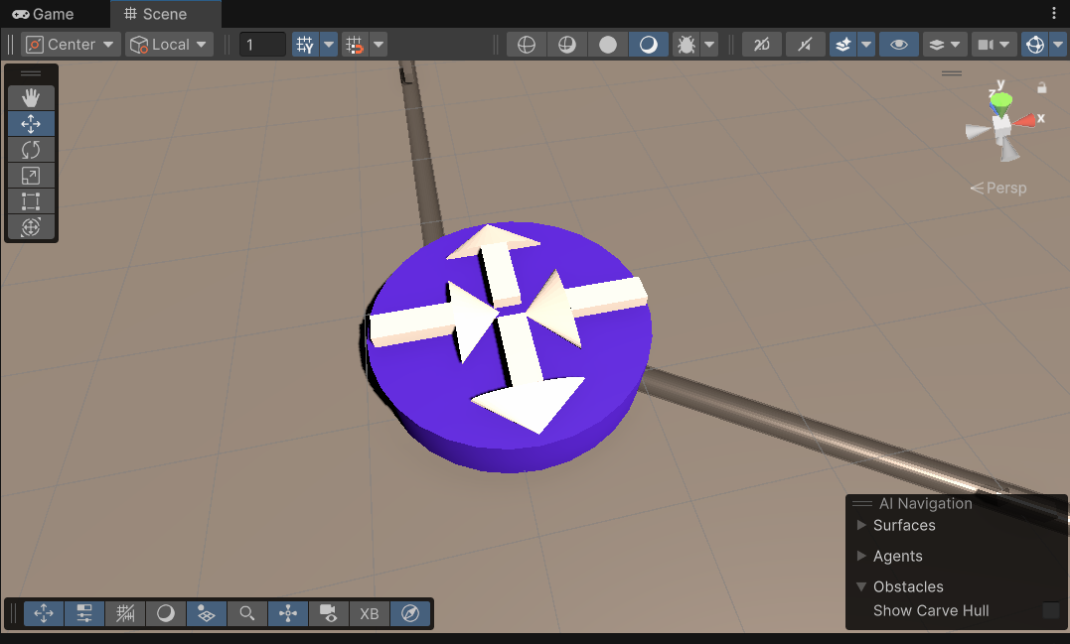
Technologies Used
Independent platforms were built with interoperability in mind
Blender, Unity, Meta Quest, Android Opensource SDK all support the same file types
Large design community

Slide 9
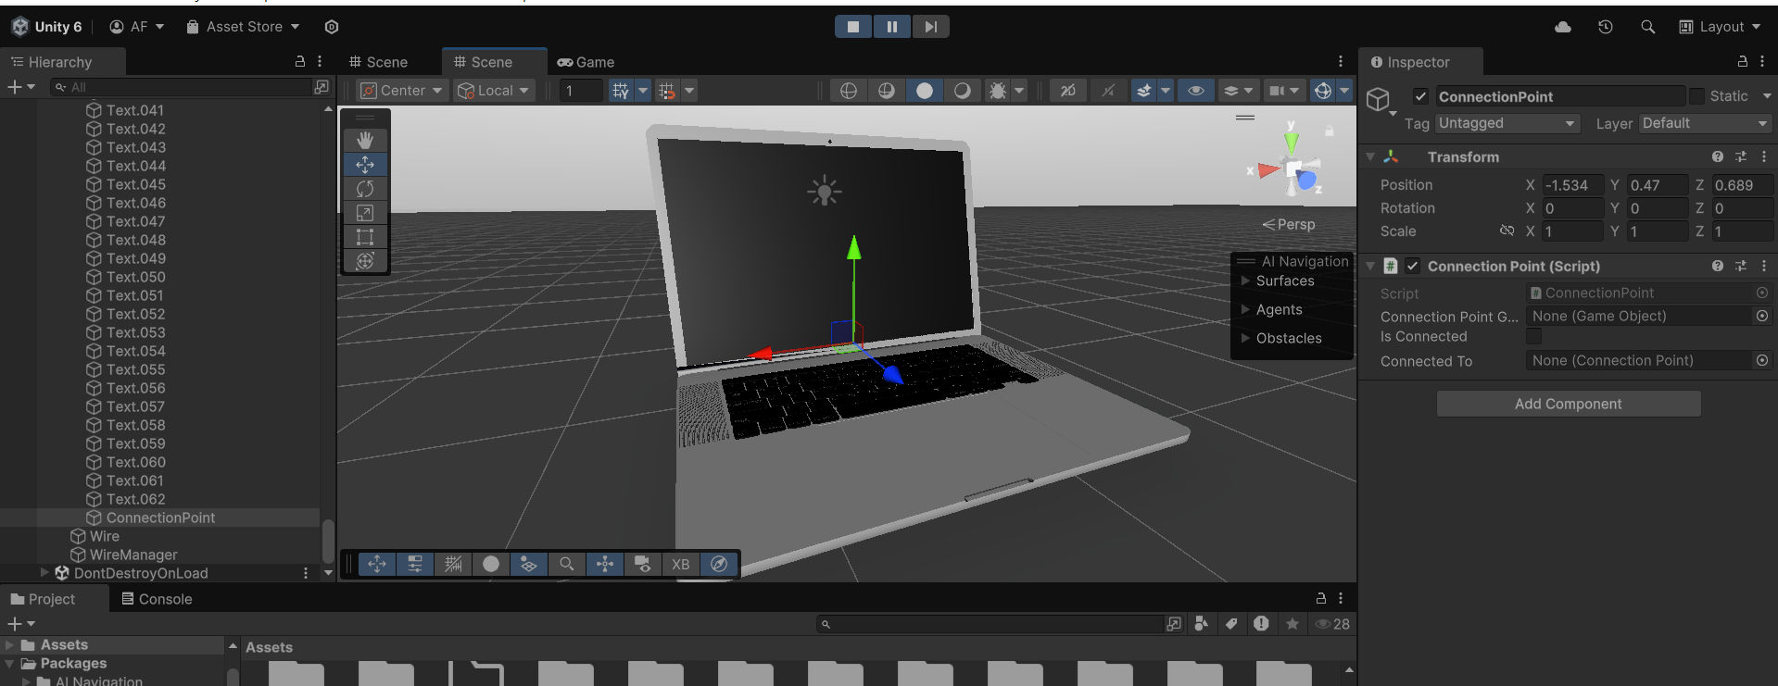
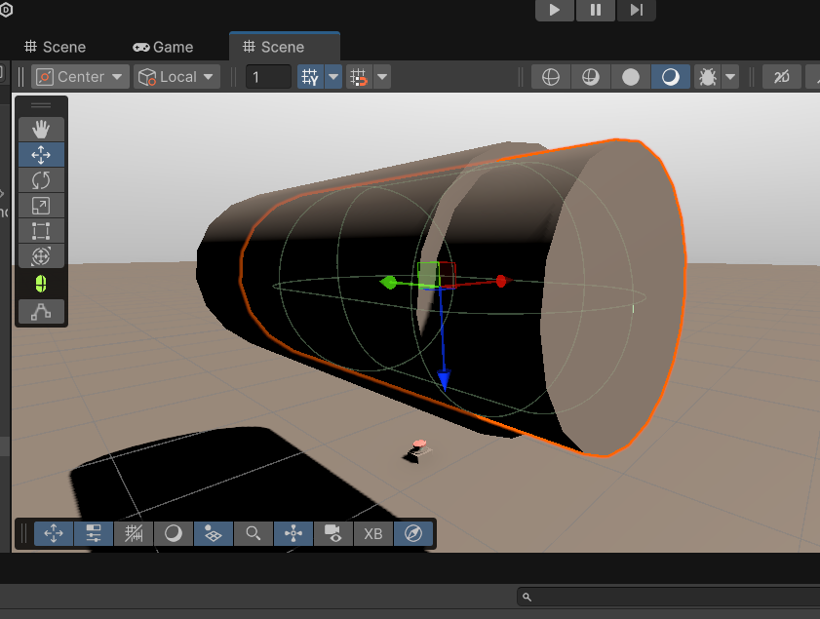
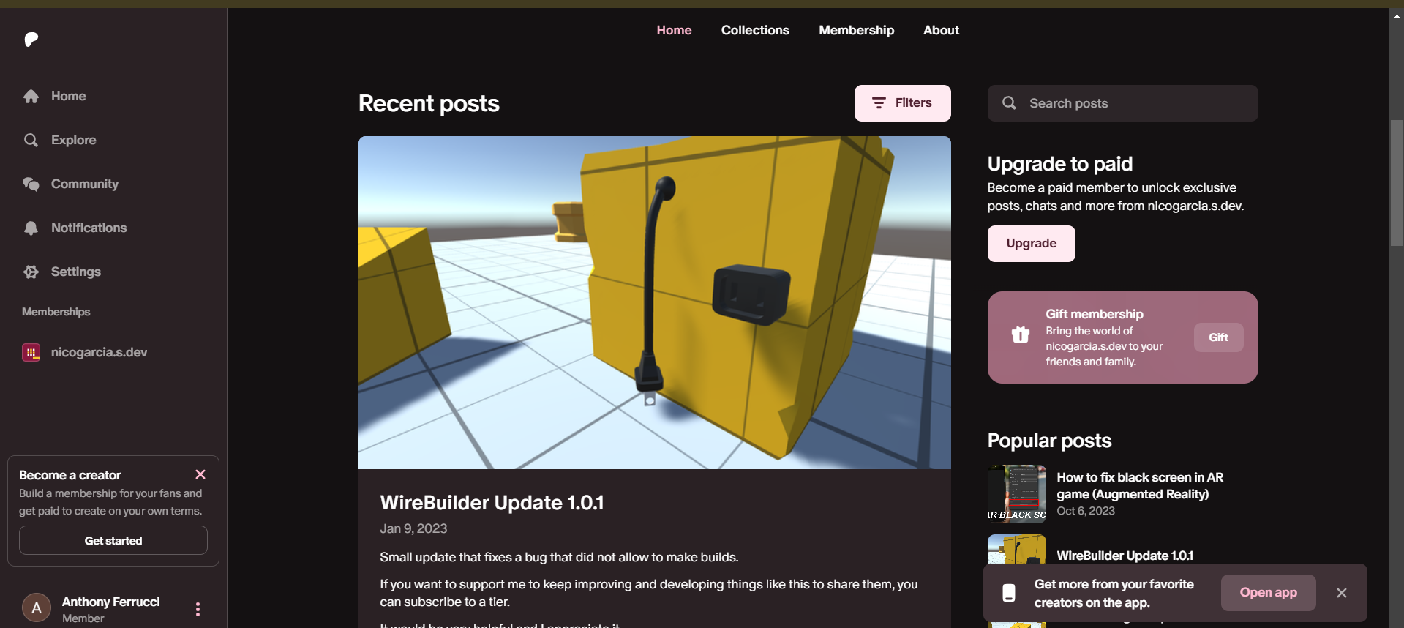
Modeling

Slide 10
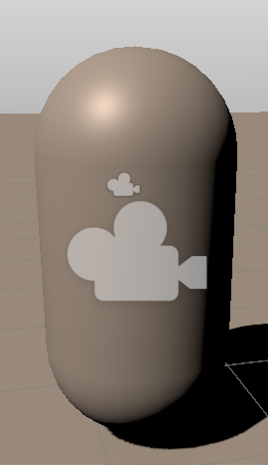
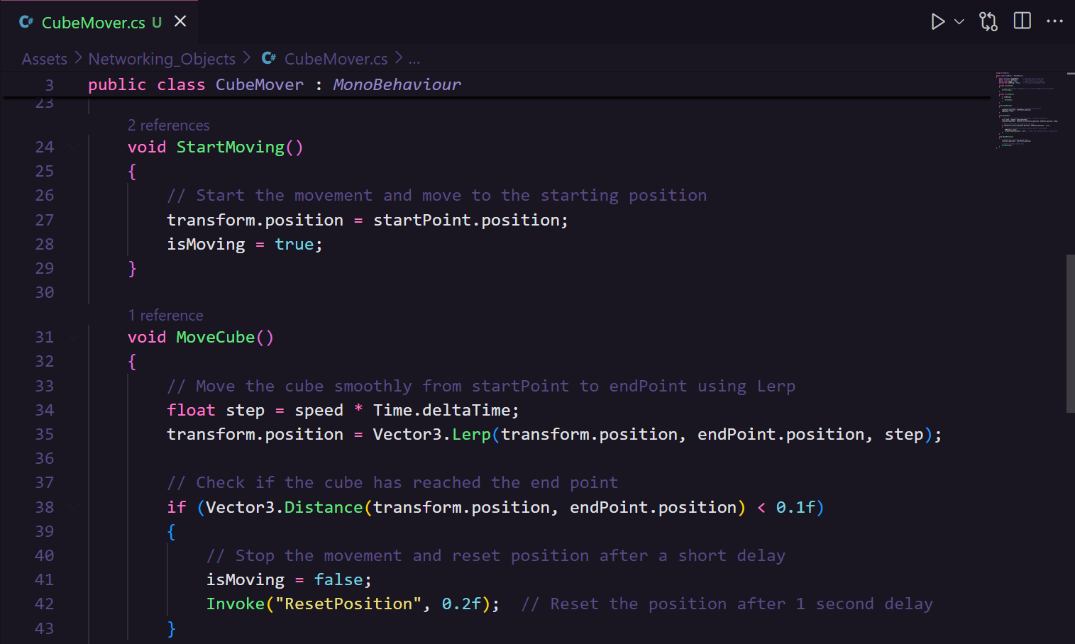
Scripts (ChatGPT!)
C#
Allows for animations
Manual debugging
OOP
Robust .NET/XR libraries

Slide 11
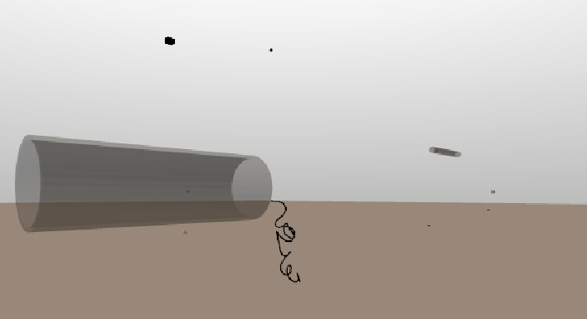
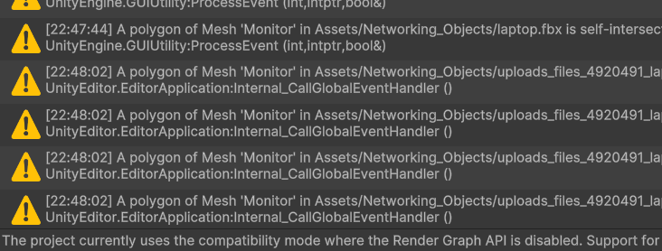
Testing Methodology
Development area
Unity Game player
Lots of breaking stuff
Failed? Try new approach

Slide 12
Issue –VR/Unity Not Cooperating
Unity only worked on one computer for a long time
Slowed development
Project wouldn't open in VR
Quest 2 minimum GPU requirement
Intel processors largely unsupported
NVDIA RTX 2000 ADA Gen laptop GPU

Slide 13
Issue – GitHub Repositories
Original minigolf template used deprecated code
Too many references to update
Had to choose new theme

Slide 14
Conclusion
Built intuitive way to understand networking
Modular enough to build own networks
Recommend using Blender from the start
Could implement interactive VR elements

Slide 15
Q&A
Questions?

